Slide 1
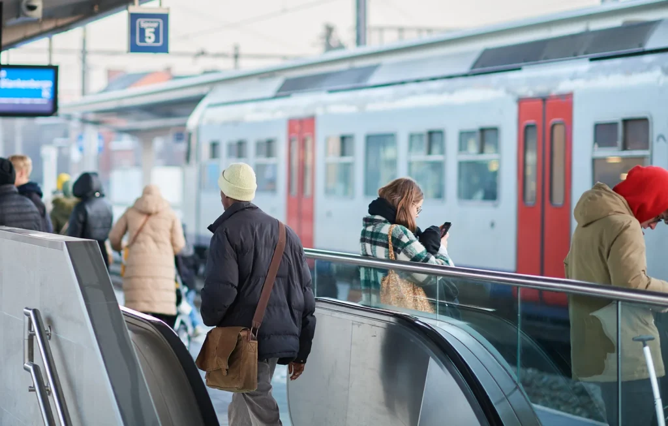

What is Happening?
01
02
04
05
07
Train Crew Shortage
“Belgium’s state-owned rail company NMBS wants to postpone the second phase of its transport plan due to a lack of train drivers and train conductors.”
(VRT News, 2024)
Background
Raising Energy Cost
Exploratory Analysis
“Belgium’s SNCB reveals impact rising energy costs are having on operations.”
(Electric and Hybrid Rail Technology, 2022)
https://www.railtech.com/wp-content/uploads/2024/02/SNCB-numbers-1024x654.webp
Revenue Loss
“The state-owned operator reports that a combination of sharply declining revenues due to low passenger numbers, and the costs of maintaining its fleet, are the primary causes of the loss.”
(International Railway Journal, 2020)

Slide 2
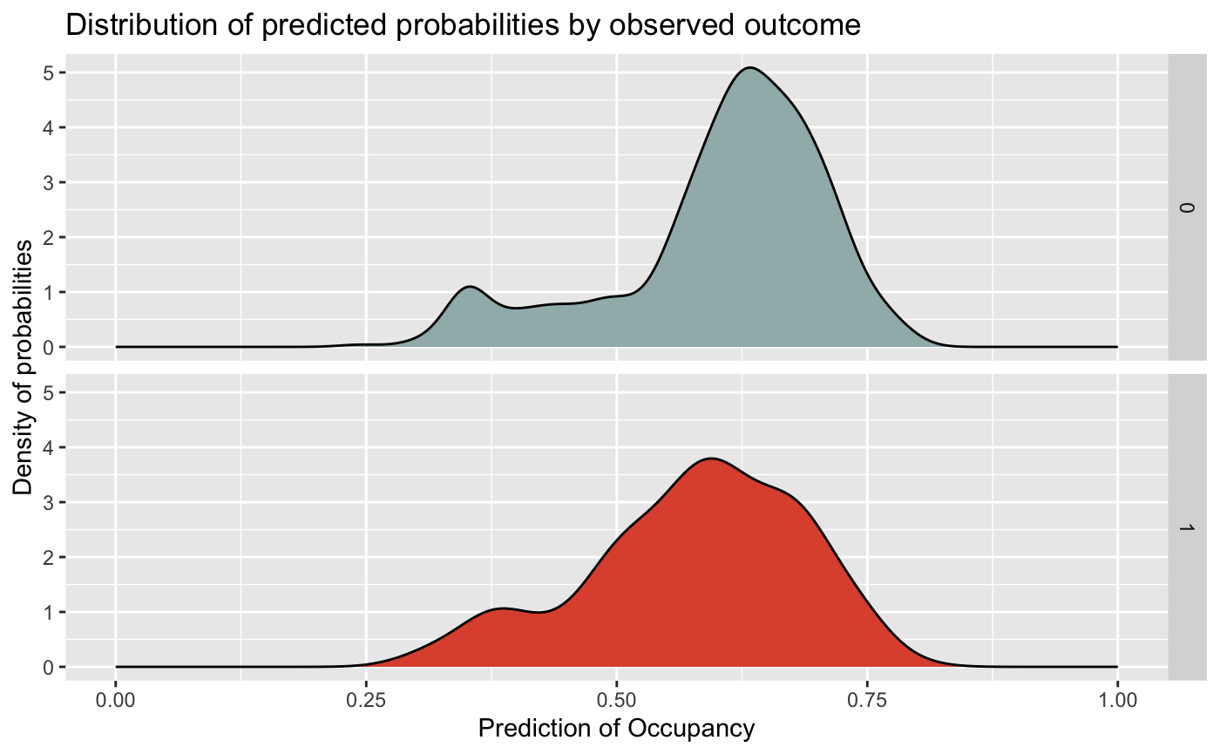
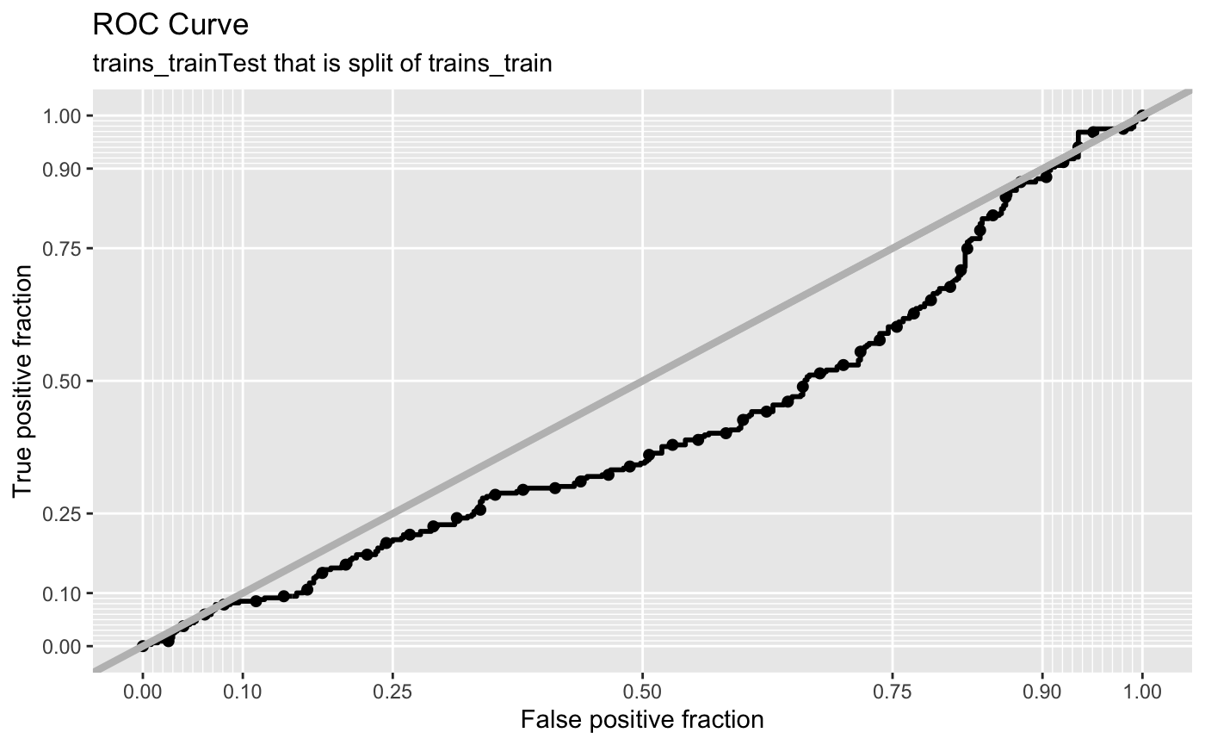
Our goals
Optimizing Resources Allocation
Optimizing Operational Cost
Increasing Revenue
Resource Allocation Prediction that NMBS currently using

Slide 3
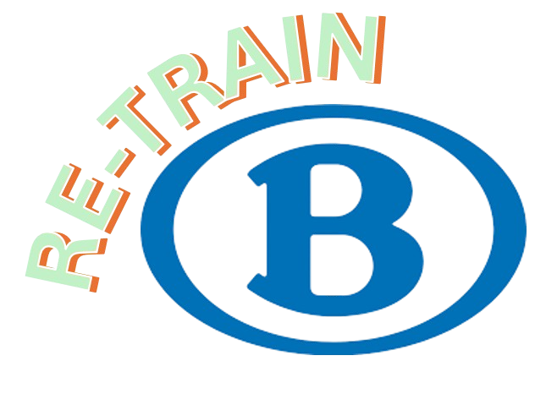
Demand-Driven Optimization for Train Services
is a web-based application for NMBS Planners to help them making decision on optimizing train based on predicted occupancy levels for all the routes in Belgium.
Features:
analysing pattern on past data
Creating custom period (long term and short term) to be predicted
Showcasing the potential benefit and risk of the prediction.

Slide 4
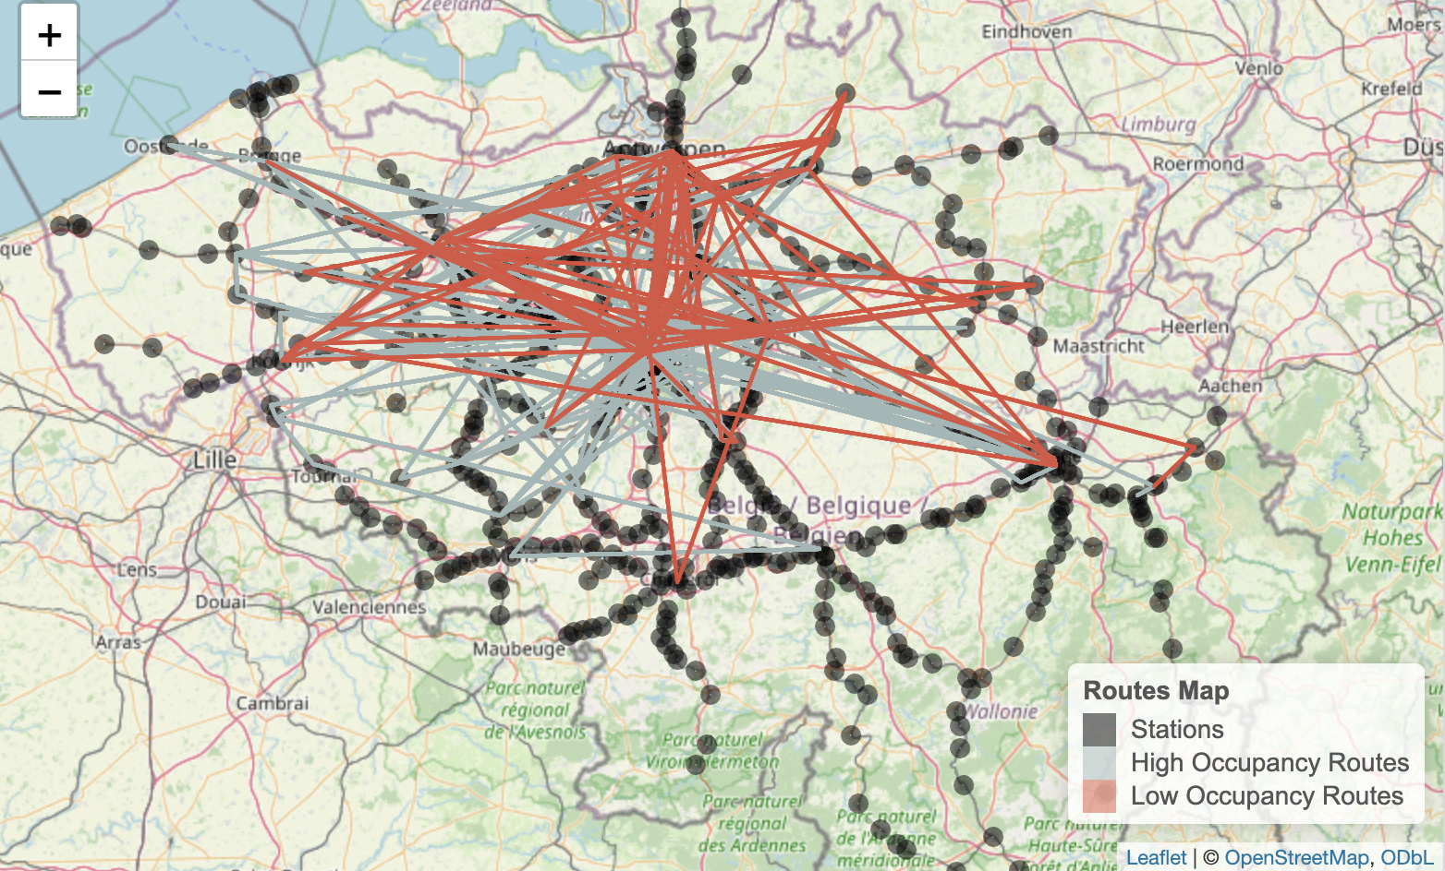
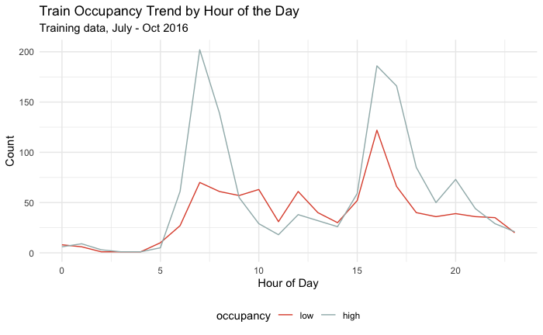
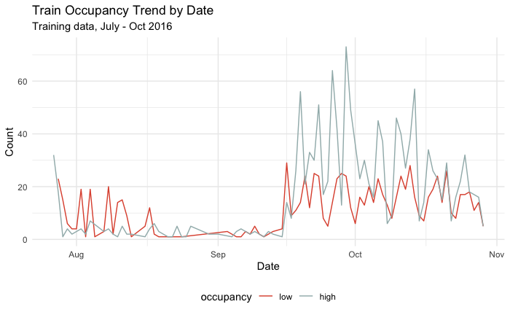
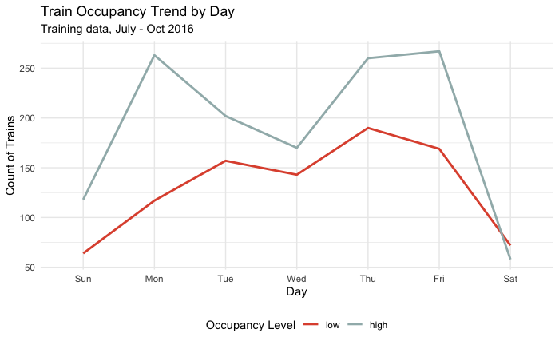
2024
Year
Date/Month
AUC
Period
Weather
82%
Routes
Analysis
Predict
Occupancy Percentage
FRR
18%
82%
0.54
Cost/Benefit Analysis
True Positive (Low-Low)
True Negative (High-High)
False Positive (Low-High)
False Negative (High-Low)
Export the report

Slide 5
2024
Year
Date/Time
AUC
Period
Weather
82%
Vehicle No.
Analysis
Predict
Occupancy Percentage
FRR
18%
82%
0.54
Cost/Benefit Analysis
True Positive (Low-Low)
True Negative (High-High)
False Positive (Low-High)
False Negative (High-Low)
Export the report

Slide 6
2024
Year
Date/Time
AUC
Period
Weather
82%
Vehicle No.
Analysis
Predict
Occupancy Percentage
FRR
18%
82%
0.54
Cost/Benefit Analysis
True Positive (Low-Low)
True Negative (High-High)
False Positive (Low-High)
False Negative (High-Low)
Export the report

Slide 7
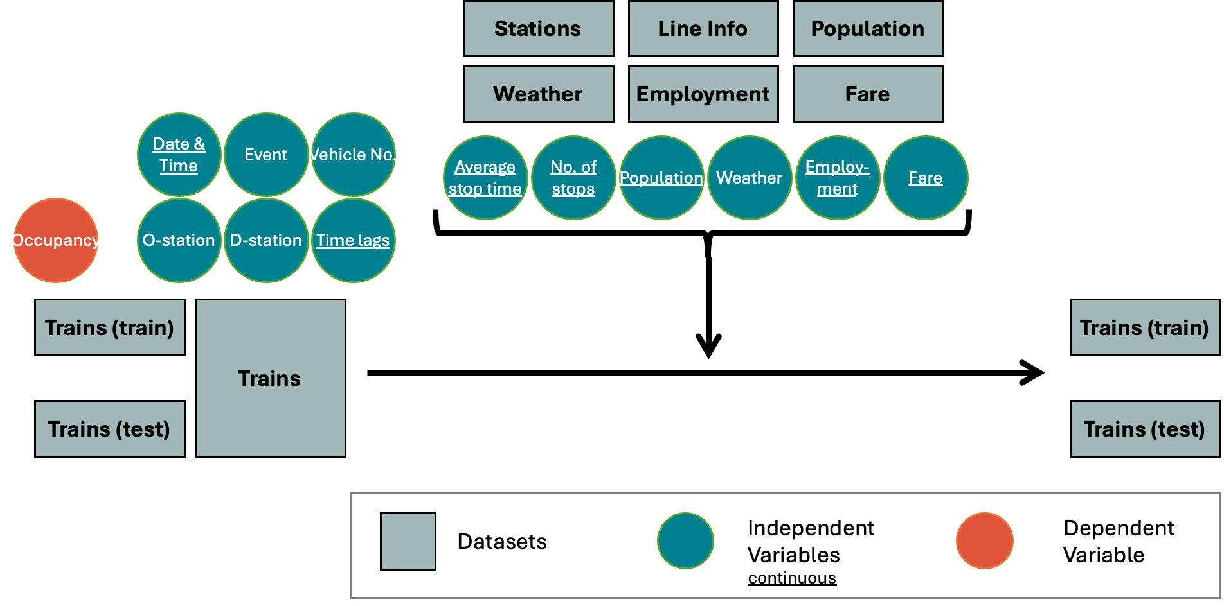
Data

Slide 8
Exploratory Analysis
1
2
3
: high-occupancy pattern
: low-occupancy pattern

Slide 9
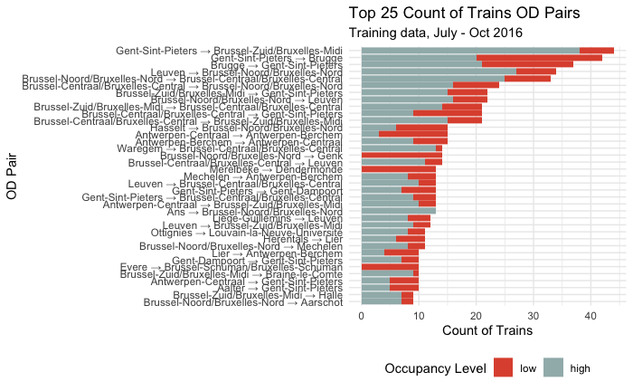
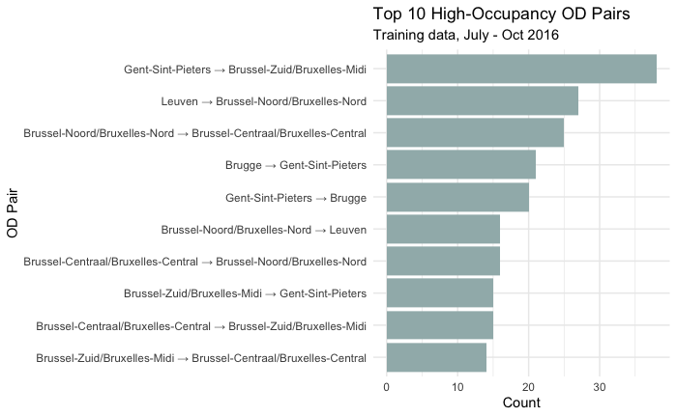
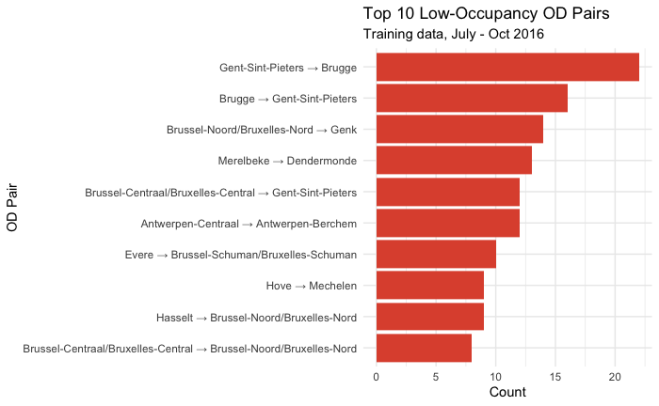
Exploratory Analysis
1
2
3
High-occupancy OD pairs are concentrated around key urban and intercity hubs, probably requiring greater resource allocation for capacity and frequency.
Low-occupancy routes are mainly regional or involve secondary stations, indicating opportunities for optimization.

Slide 10
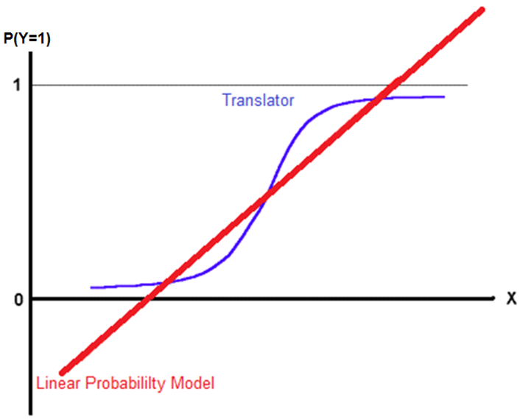
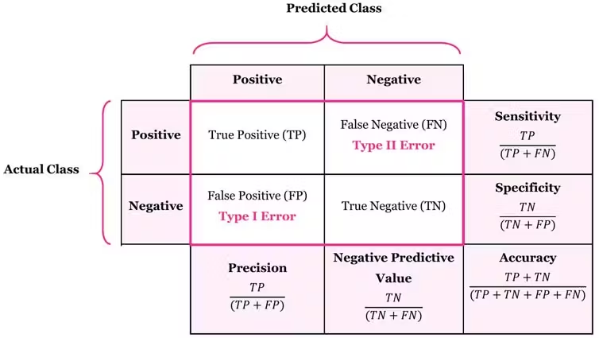
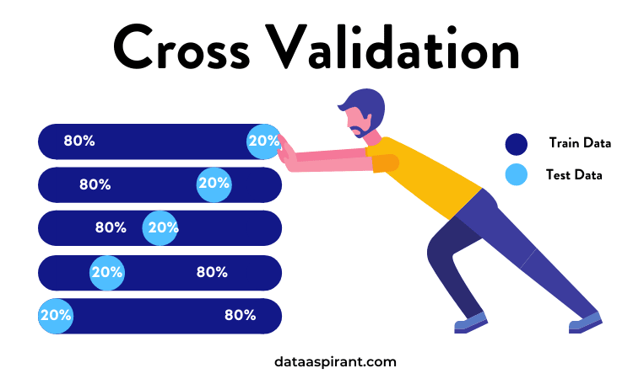
Modeling
Logistic Regression
Use a statistical method to predict outcomes (high or low) based on the data. This helps us see which factors are important for making predictions.
https://encord.com/glossary/confusion-matrix/
Cross-Validation
Goodness of Fit
(Confusion Matrix)
Test the model on different parts of the data to check how well it works, focusing on how often it correctly identifies positive cases (sensitivity).
Use a table to measure how well the model predicts outcomes. This shows how accurate and reliable the predictions are.

Slide 11
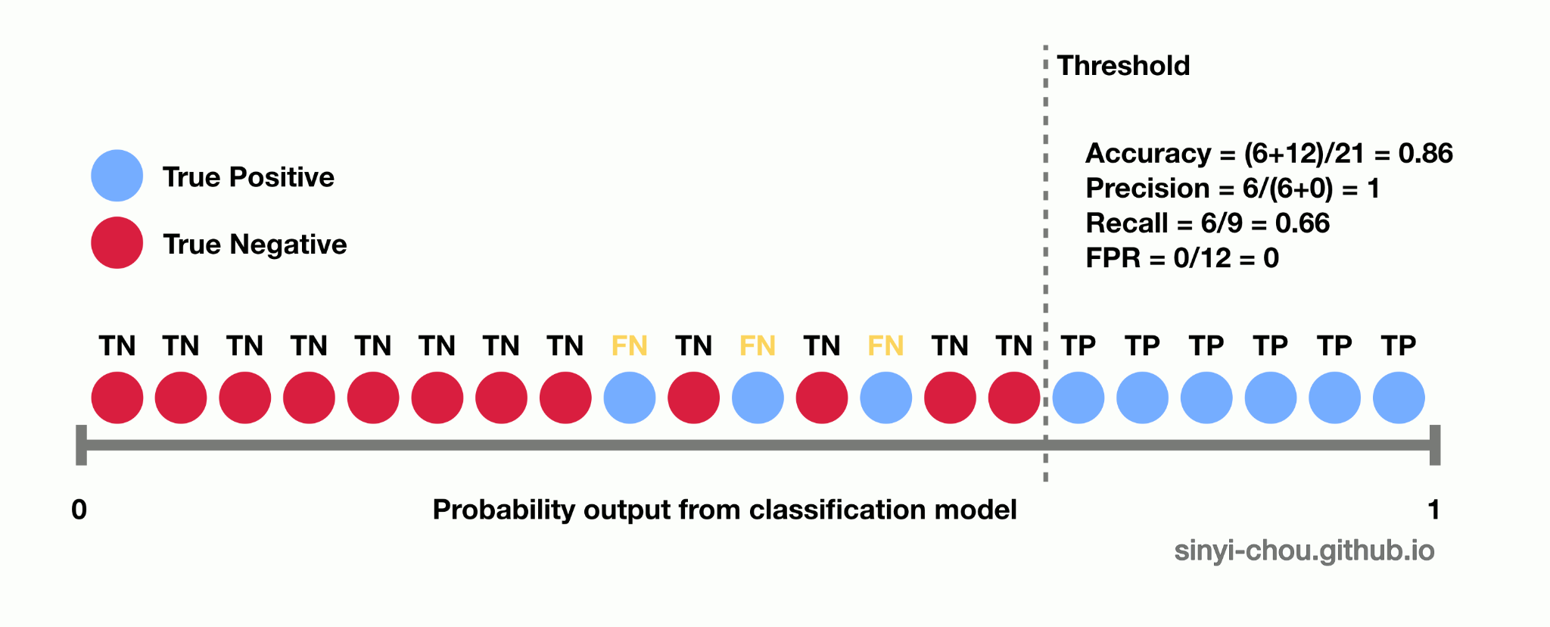
Optimal Threshold
Incorrectly identifying high-occupancy routes as low will be fatal.
To minimize:
Set a Higher Threshold: Increase the threshold for classifying a route as low occupancy. This ensures only routes with a strong likelihood of low occupancy are flagged, reducing the chance of misclassifying high-occupancy routes.

Slide 12

Cost-Benefit Analysis Formula
Category | Cost | Benefit
Correctly Predict Low Occupancy | - Maintenance cost savings - Labor cost reduction - Marketing cost (more promotion to boost ridership) | - Energy cost savings (fewer trains, less energy usage). - Avoid wasted resources.
Incorrectly Predict Low Occupancy | - Revenue loss from overcrowding or under-serving high-demand routes. - Increased passenger dissatisfaction (potential future revenue loss). | - Potential short-term operational savings (if incorrectly reallocating).
Incorrectly Predict High Occupancy | - Continued inefficiency (maintaining low-demand routes). - Missed opportunity to save on labor, maintenance, and energy costs. | - Service reliability maintained (no disruption to high-demand routes).
Correctly Predict High Occupancy | None (accurate prediction means no wasted resources). | - Maximized fare revenue from high-demand routes. - Resource optimization (ensuring enough capacity for high-demand routes).

Slide 13
Thanks!
Indriaty, Tutut
Jun, Youngsang

